Slide 1
Sketch and Description of a Locus

Slide 2

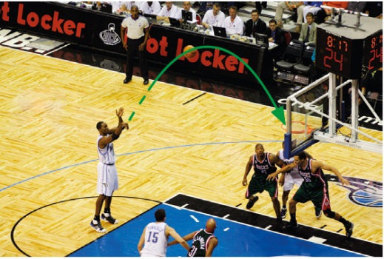
Concept of Locus
In daily life, we can see many examples of paths traced by moving objects.
The path traced by a basketball is a curve, which is part of a parabola.
The path traced by the tip of the second hand of a clock is a circle.
The path traced by the moving object under certain condition(s) is called its locus.
In Mathematics,
a locus is a collection of points which satisfy one or more given conditions.

Slide 3

Sketch and Description of a Locus
Consider a point P which moves under the condition below: "Maintain a fixed distance of 4 cm from a fixed point A."
A simple way to find the locus of the moving point P is to draw several points which satisfy the given conditions,
and then sketching the locus of P.
P
4 cm
A

Slide 4
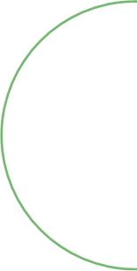
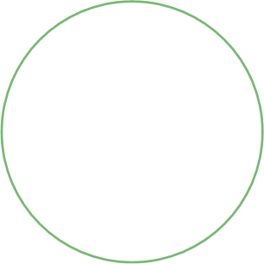
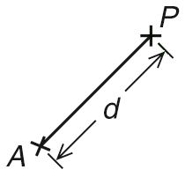

Now, let us consider the general case of the condition just discussed.
Condition I:
A moving point P maintains a fixed distance d from a fixed point A.
Besides showing the locus by a sketch, we can also describe the locus in words.
locus of P

Slide 5
Condition I:
A moving point P maintains a fixed distance d from a fixed point A.
In describing the locus of a moving point,
P
we should state the main features of the locus such as
d
d
A
the shape
A
the position
locus of P
the size
Locus of P :
A circle
with centre A
and radius d.

Slide 6
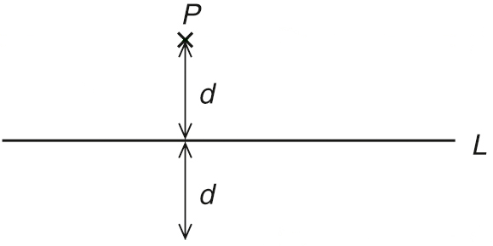
Now, let us consider the loci of points which move under other conditions and the sketches of these loci.
Condition II:
A moving point P maintains a fixed distance d from a straight line L.
L₁
locus of P
L₂
Locus of P :
A pair of straight lines L₁ and L₂ parallel to and at a distance d from L.

Slide 7
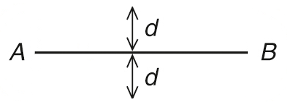


Condition III:
A moving point P maintains a fixed distance d from a line segment AB.
Locus of P :
It is made up of:
(i) two parallel line segments, each of length equal to AB, and at a distance d from AB, and;
(ii) two semi-circles each of radius d, with centres A and B respectively.
P
locus of P

Slide 8
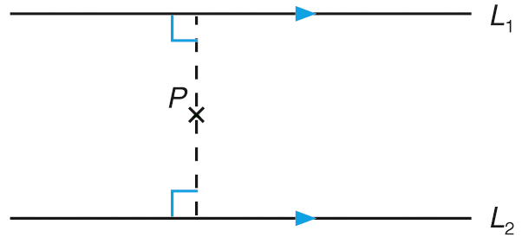
Condition IV:
A moving point P maintains an equal distance from two parallel lines L₁ and L₂.
locus of P
L
Locus of P :
A straight line L parallel to and midway between L₁ and L₂.

Slide 9
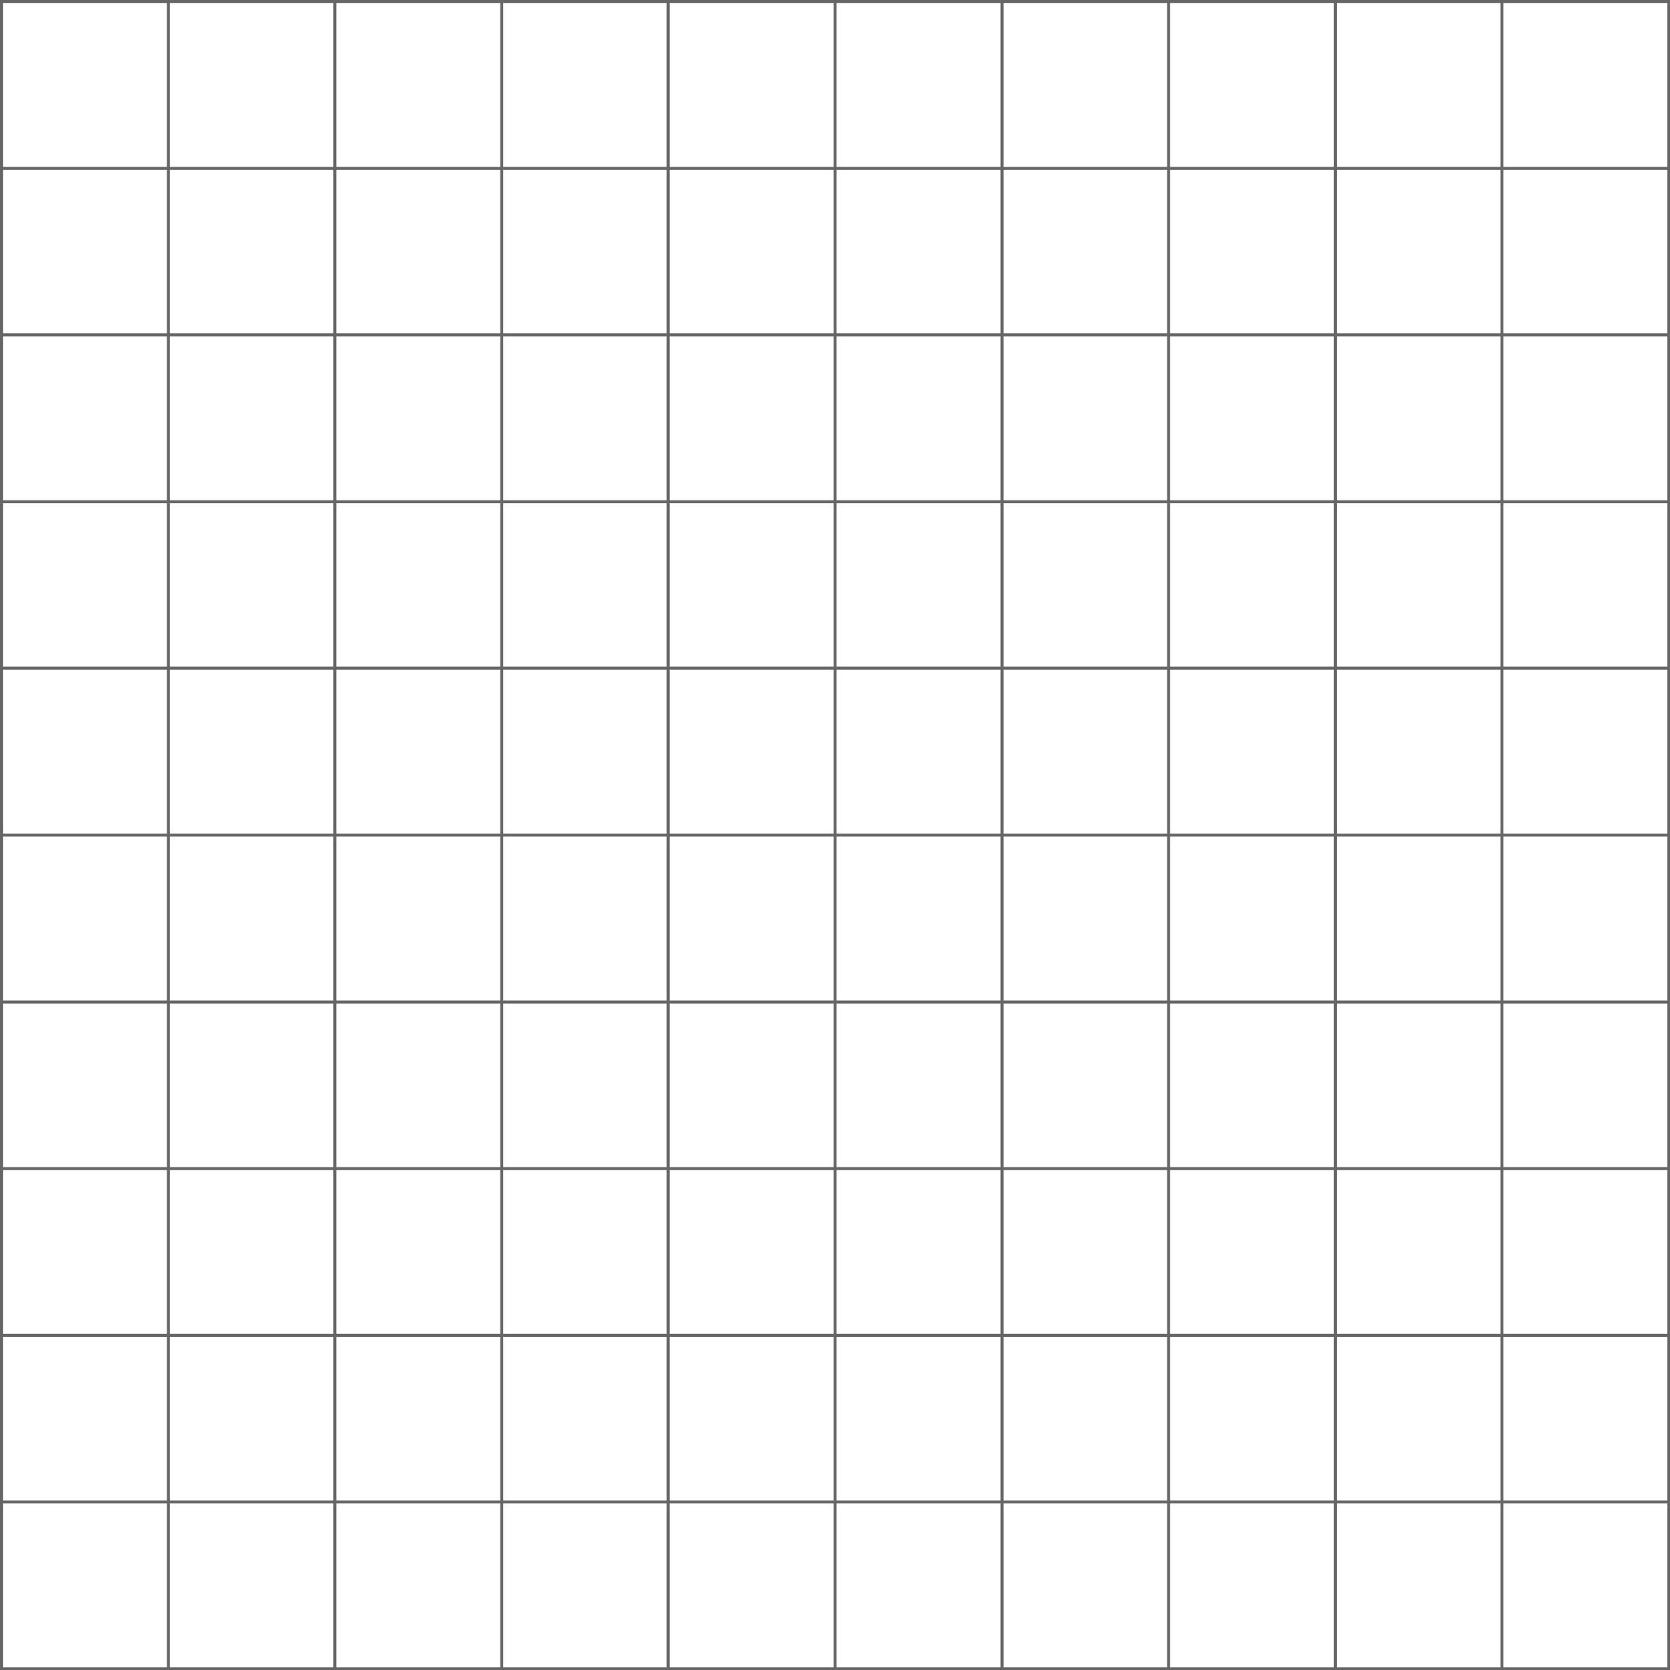
Follow-up question
Under each of the following conditions, sketch and describe the locus of a moving point P.
P maintains a fixed distance 3 units from the straight line L.
L₁
L
L₂
The locus of P is a pair of straight lines L₁ and L₂ parallel to and at a distance 3 units from L.

Slide 10
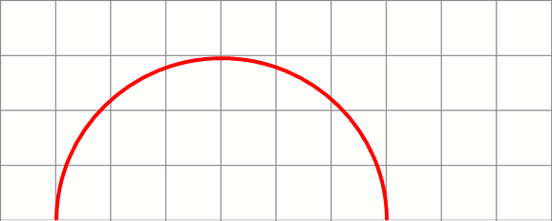
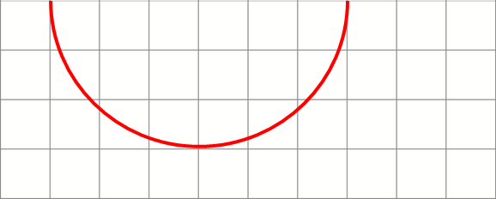
Follow-up question
Under each of the following conditions, sketch and describe the locus of a moving point P.
P maintains a fixed distance 3 units from a line segment AB.
The locus of P is made up of:
(i) two parallel line segments, each of length equal to AB, and at a distance 3 units from AB, and;
A
(ii) two semi-circles each of radius 3 units, with centres A and B respectively.
B

Slide 11



Condition V:
A moving point P maintains an equal distance from two fixed points A and B.
A
locus of P
P
B
Locus of P :
The perpendicular bisector of line segment AB.

Slide 12
Condition VI:
A moving point P maintains an equal distance from two intersecting lines L₁ and L₂.
locus of P
L₂
L₁
P
The two angle bisectors are perpendicular to each other.
Locus of P :
The two angle bisectors of the angles formed by the two intersecting lines L₁ and L₂.

Slide 13

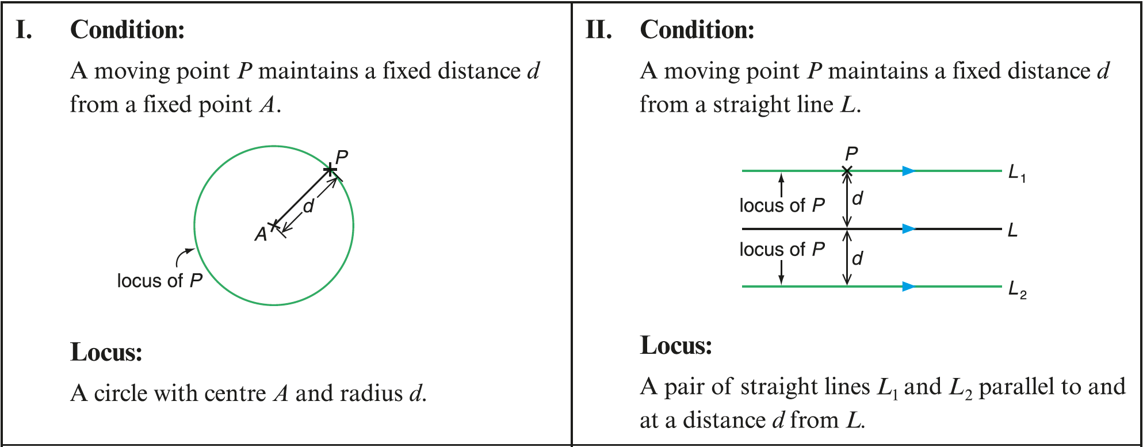
Let me summarize the loci of the 6 cases discussed.

Slide 14
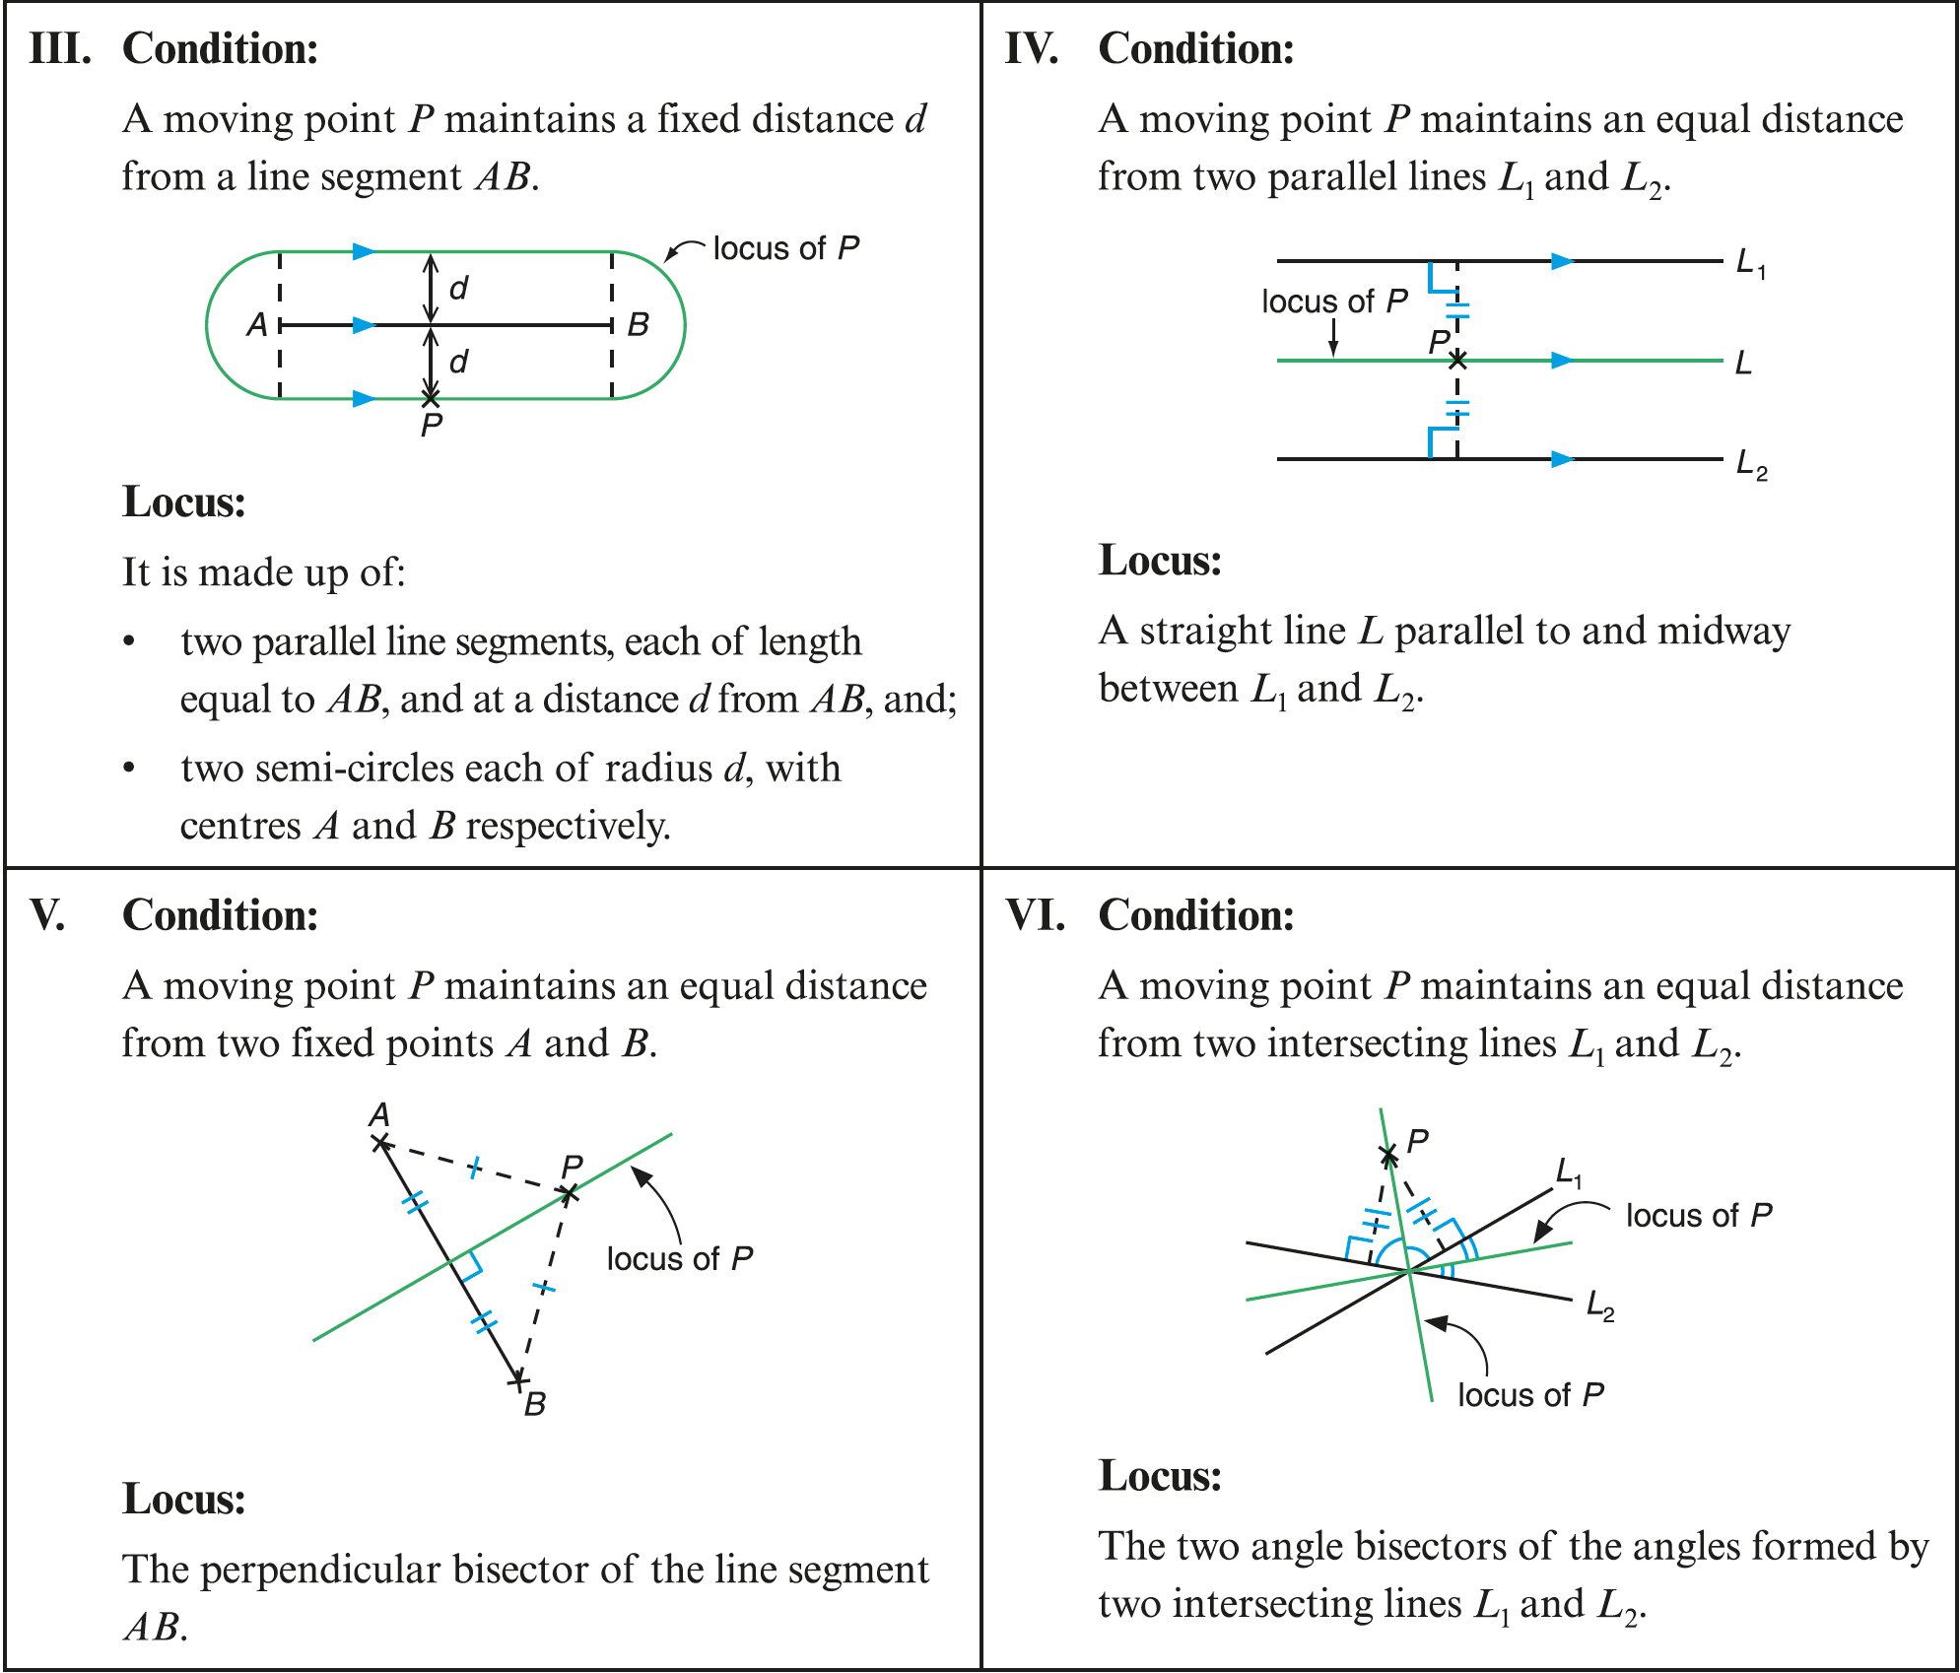

Slide 15
Let us take a look at the following example.
The figure shows a fixed larger circle with centre O and radius 9 cm, and a movable smaller circle with centre P and radius 3 cm. The smaller circle rolls inside the larger circle along its circumference. Sketch and describe the locus of P.
9 cm
P
3 cm
O

Slide 16
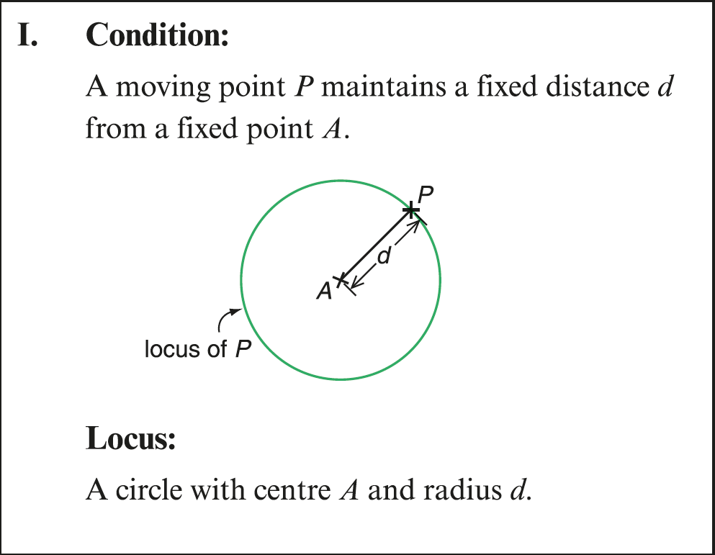

Note that
the distance between O and P
= radius of the larger circle – radius of the smaller circle
9 cm
Notice that P maintains a fixed distance from O so the locus of P is a circle.
P
3 cm
O
= (9 – 3) cm
= 6 cm
The locus of P is a circle with centre O and radius 6 cm.

Slide 17




Follow-up question
The figure shows a square of side 4 cm. P is a moving point which maintains 1 cm from the nearest point on the square. Sketch and describe the locus of P.
The locus of P is made up of:
(i) a square of side 2 cm,
4 cm
(ii) two pairs of parallel line segments, each at a distance of 1 cm outside the square, and;
1 cm
1 cm
1 cm
(iii) four quarter-circles each of radius 1 cm, centred at the four vertices of the square respectively.
locus of P

